Slide 1
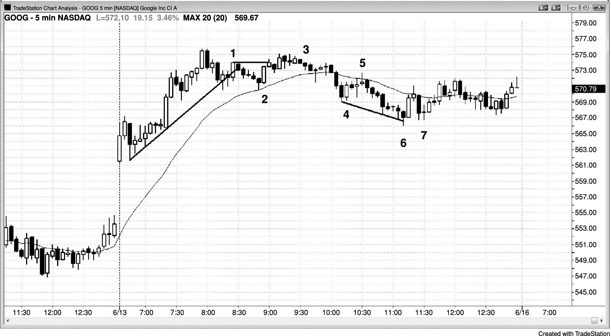
FIGURE 26.1 At Least Two Reasons to Take a Trade

Slide 2
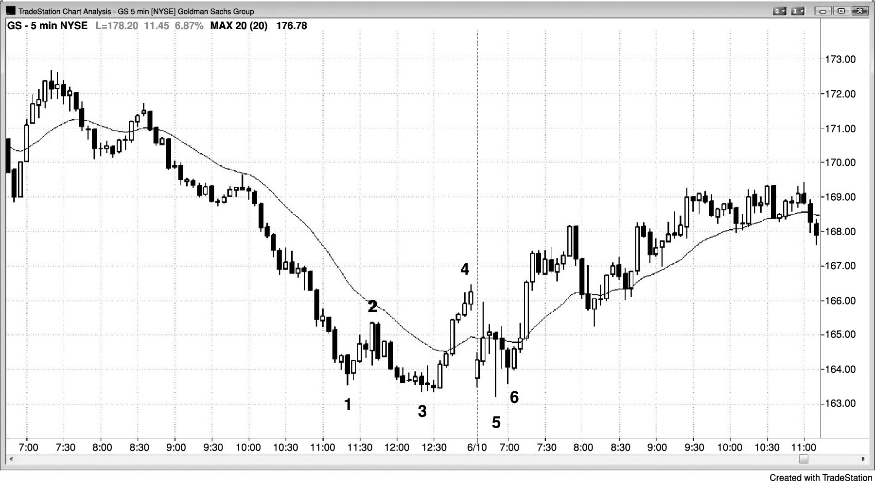
FIGURE 26.2 Expanding Triangle

Slide 3
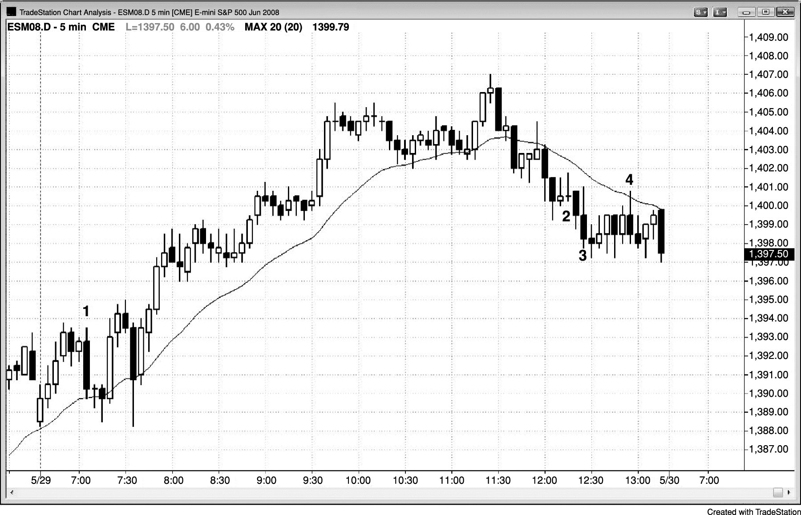
FIGURE 26.3 Two Reasons to Take a Trade

Slide 4
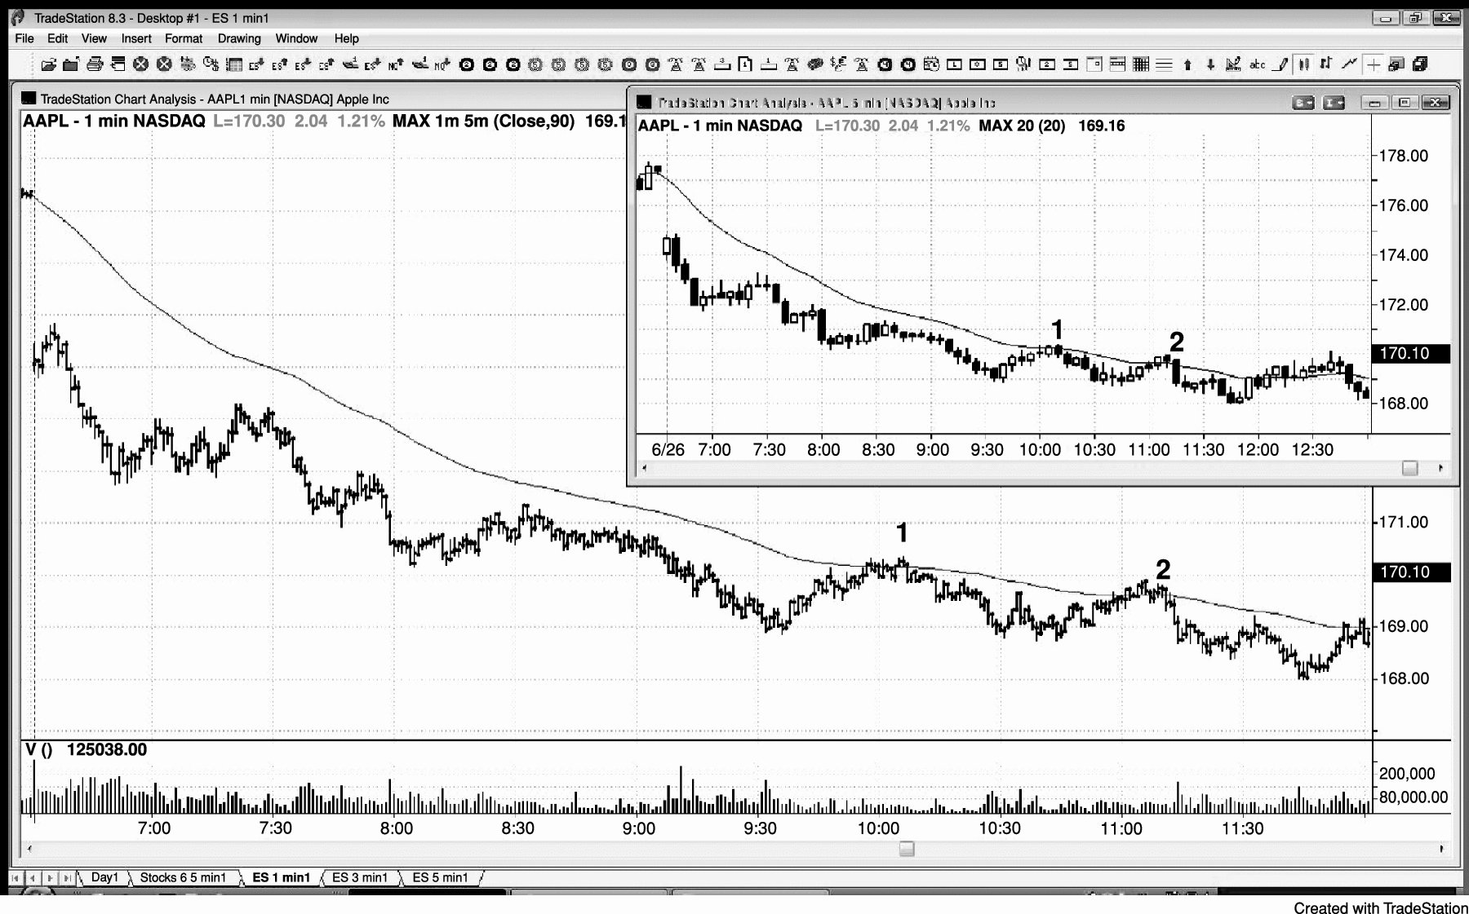
FIGURE 26.4 Moving Average Pullback Short

Slide 5
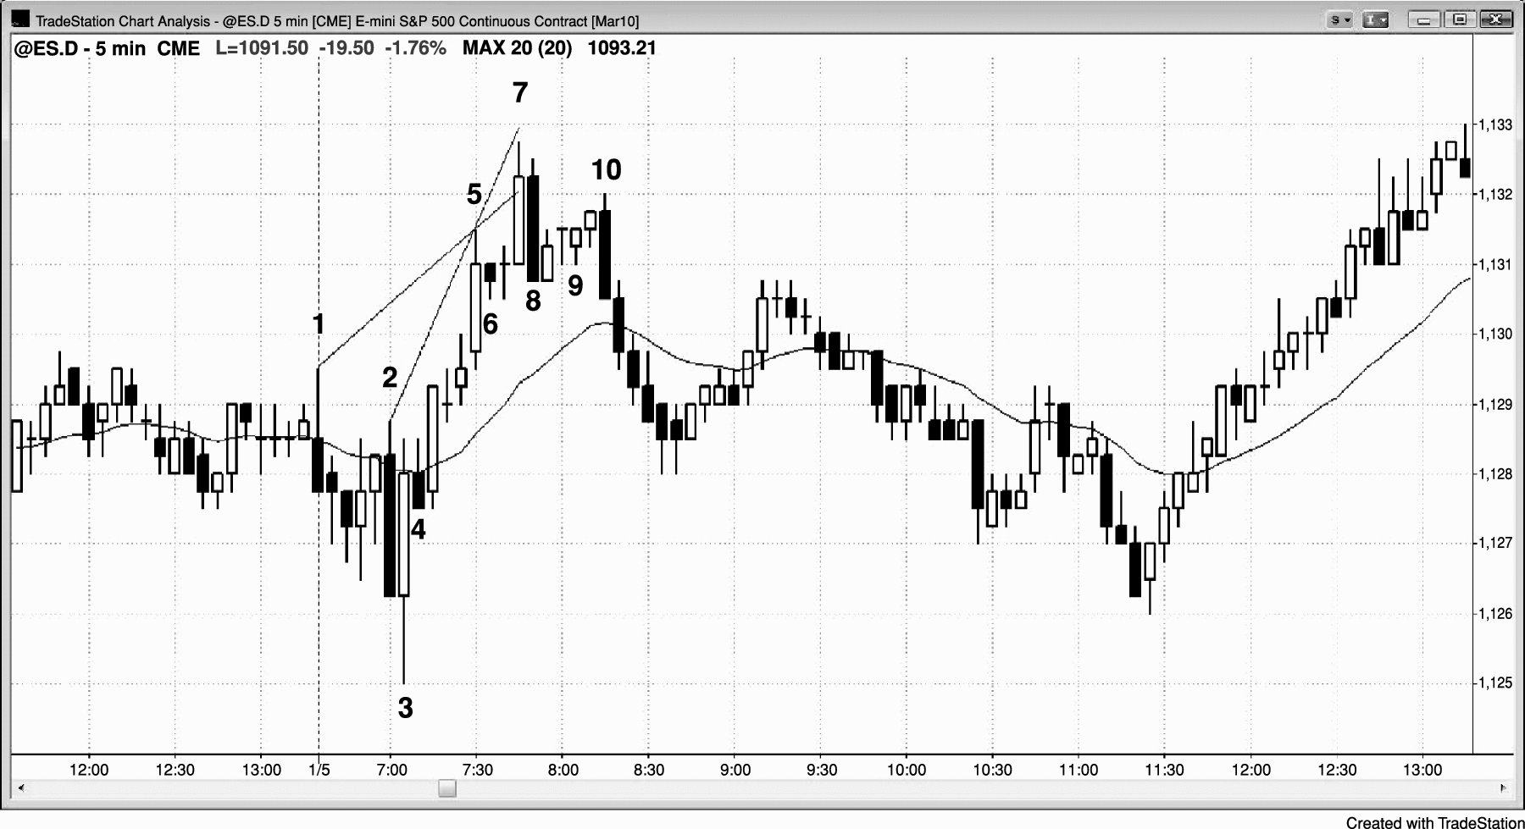
FIGURE 26.5 When a Channel Is Tight, Wait for a Second Signal

Slide 6
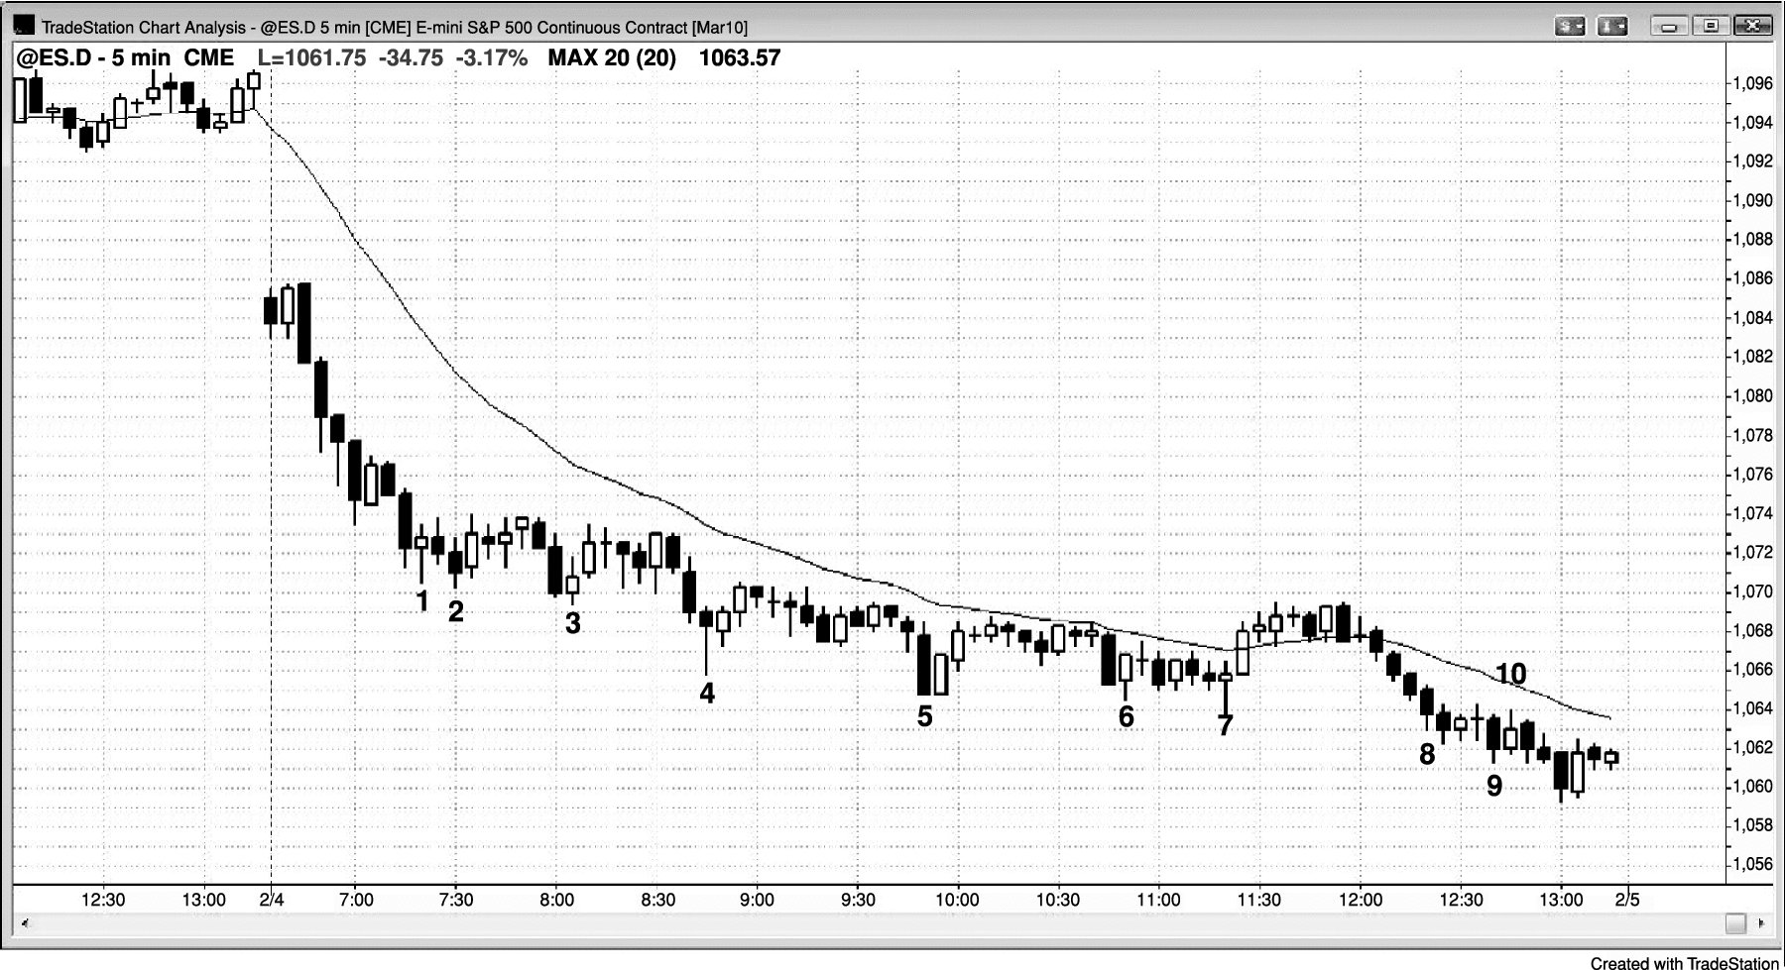
FIGURE 26.6 Buying New Lows in a Bear Trend

